Slide 1
Domestic Advocacy
January 17, 2020

Slide 2
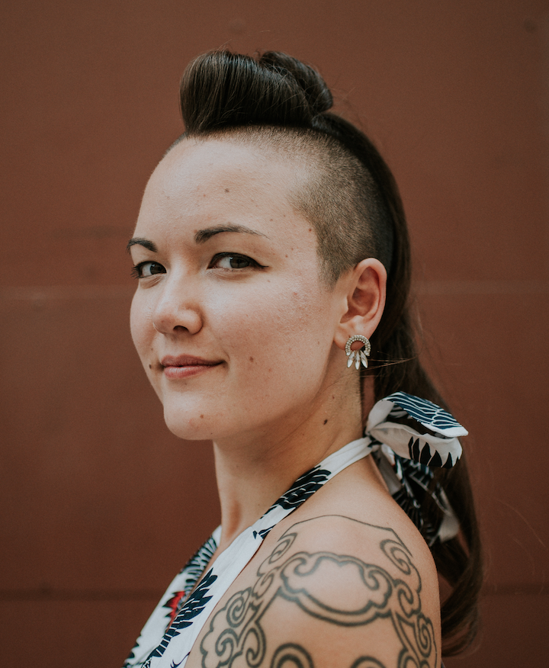
Facilitator
Whitney Yang,
US Human Rights Network
Chief of Strategy and Programming

Slide 3
Agenda
Introduction (10 mins)
Presentation by Guest Member Stephanie Franklin (10-15 mins)
Presentation by UPR Task Force Co-Chairs Mary Gerisch and Joshua Cooper: January 23/24 Consultations with Embassies and UN Missions (15 mins)
Presentation by UPR Task Force Member Jamil Dakwar: January 27 US Government Consultation (5-10 mins)
Q&A - Chatbox (10-15 mins)

Slide 4
Code of Conduct
Our online webinars, conference calls, and meetings are dedicated to providing a harassment-free and hatred-free experience for everyone.
The Network firmly believes that we are stronger together; we strive to contribute to a human rights movement in which human rights defenders from across regions, issue areas, and communities work together to uplift each other in the struggle for human rights and dignity for all.
For further information on our code of conduct, please visit www.ushrnetwork.org/blog

Slide 5
Be open
Be inclusive
Be collaborative
Listen to other members
Use welcoming and inclusive language
Be supportive of other members on the call
Be mindful of the time you take in meetings
Be respectful of differing viewpoints and experiences
Respect others regardless of race, color, religion, sex, national origin, immigration status, age, disability, sexual orientation, or gender expression
No hate speech
No Oppression Olympics
No exclusionary language
No sustained disruption of discussion
No discrimination*, harassment, or defamatory language
*Discrimination includes: Unjust/prejudicial treatment and/or comments related to gender, gender identity and expression, sexual orientation, disability, mental illness, neuro(a)typicality, physical appearance, pregnancy status, veteran status, political affiliation, marital status, body size, age, race, national origin, ethnic origin, nationality, immigration status, language, religion or lack thereof, or other identity marker. This includes anti-Indigenous, anti-Black, anti-immigrant and/or xenophobic language, deliberate misgendering, using inappropriate pronouns, and use of "dead" or rejected names.
Notes:
If a member engages in discriminatory or harassing behavior, the USHRN Coordinating Center facilitators may take any action they deem appropriate, including warning the offender and/or expulsion from the call as needed in order to maintain a discrimination-free and harassment-free environment.

Slide 6
UPR Advocacy
1 - 2 page report summaries & thematic consultations: meetings in New York (Jan 23) and Washington D.C. (Jan 24)
Support to members traveling to Geneva for the review
Fundraising initiative: www.upr2020.org/contribute
Fill out the form if you plan to travel to Geneva: https://bit.ly/2RtunQ6
Public education and awareness raising
#TellTheWorld Art Competition: www.upr2020.org/telltheworld

Slide 7
Upcoming Consultations
Stakeholder-state sessions
Discussions with global diplomatic community members
Discussions can form the basis of the intervention by states at the review in Geneva
USHRN has invited key UN Missions (New York) and embassies (D.C.) to consultations

Slide 8
Upcoming Consultations

Slide 9
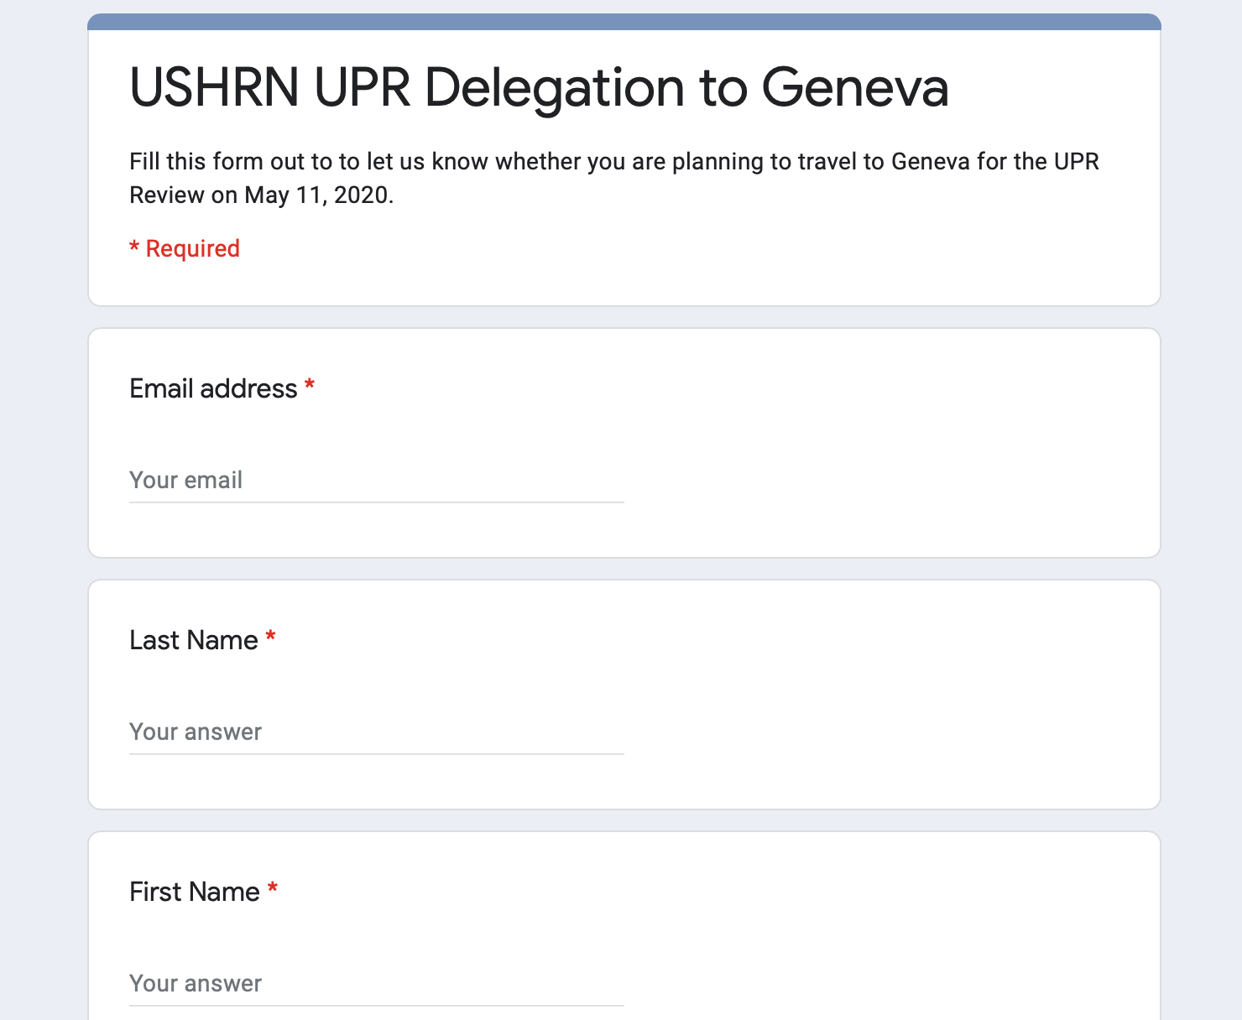
Geneva (May 11)
https://bit.ly/2RtunQ6
Link available via:
www.upr2020.org/resources
We will send further coordination information via email & discuss Geneva travel on the next Webinar #10

Slide 10
#TellTheWorld - Deadline Extension

Slide 11
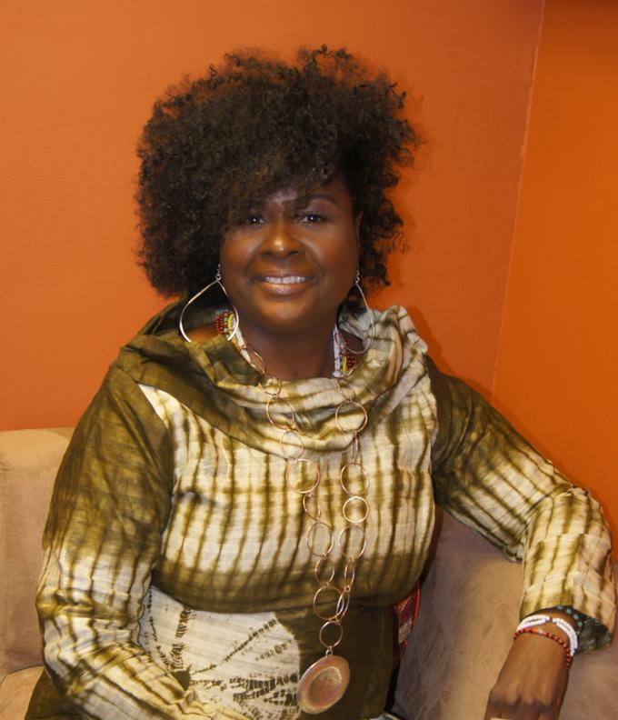
Guest Advocate
Stephanie Franklin,
Franklin Law Group

Slide 12
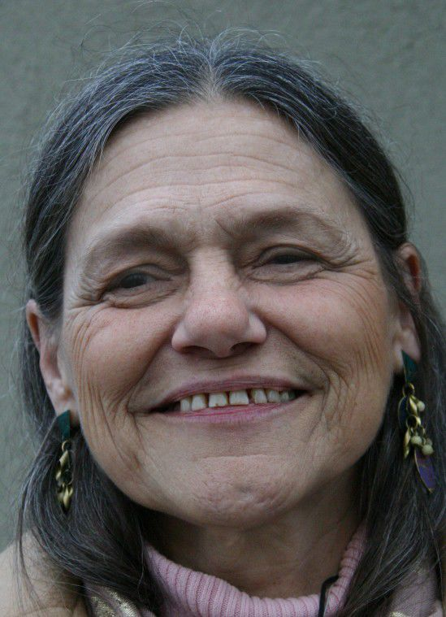
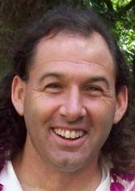
Guest Advocates
Mary Gerisch + Joshua Cooper
UPR Task Force Co-Chairs

Slide 13
Guest Advocate
Jamil Dakwar,
UPR Task Force Member
Director of the ACLU Human Rights Program

Slide 14
US Government Consultation (D.C.)
Monday, January 27, 2020 from 1:30 p.m. to 3:30 p.m.
State Department, Washington, D.C.
NGO Consultation with US Government
Please RSVP to FuentesTA@state.gov and FalconSappLA@state.gov no later than 5:00 p.m. Wednesday, January 22, with the following information: (a) your name, phone number and email address, (b) institutional affiliation, (c) the name, phone number and email address of the representative participating, and (d) whether you will participate in person or by telephone.
This information is available on: www.upr2020.org/resources

Slide 15
Q&A

Slide 16
Thank you
www.upr2020.org
ushrnetwork ushrn ushrnetwork

